Slide 1
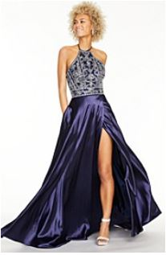
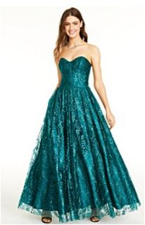

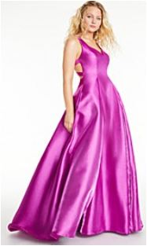
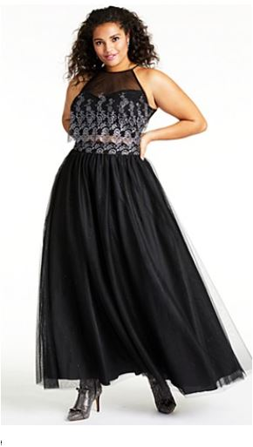

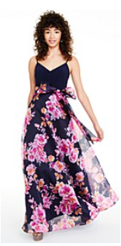
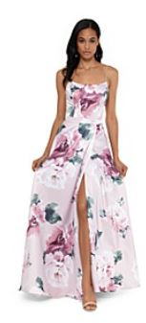

Enjoy the Wonder of Prom!
Macy’s Crossgates
Dresses , 1st Floor
Saturday, 12-4 PM
25% off all regular, sale and clearance priced Prom dresses
MAR
15th
Join us for an exclusive 2020 Prom Party event and check out all the trending styles as well as special perks just for you!
Get a free make-over, take your best selfie at our Prom selfie station, enjoy complimentary refreshments and enter to win raffles.
Event subject to change or cancellation.

