Slide 1



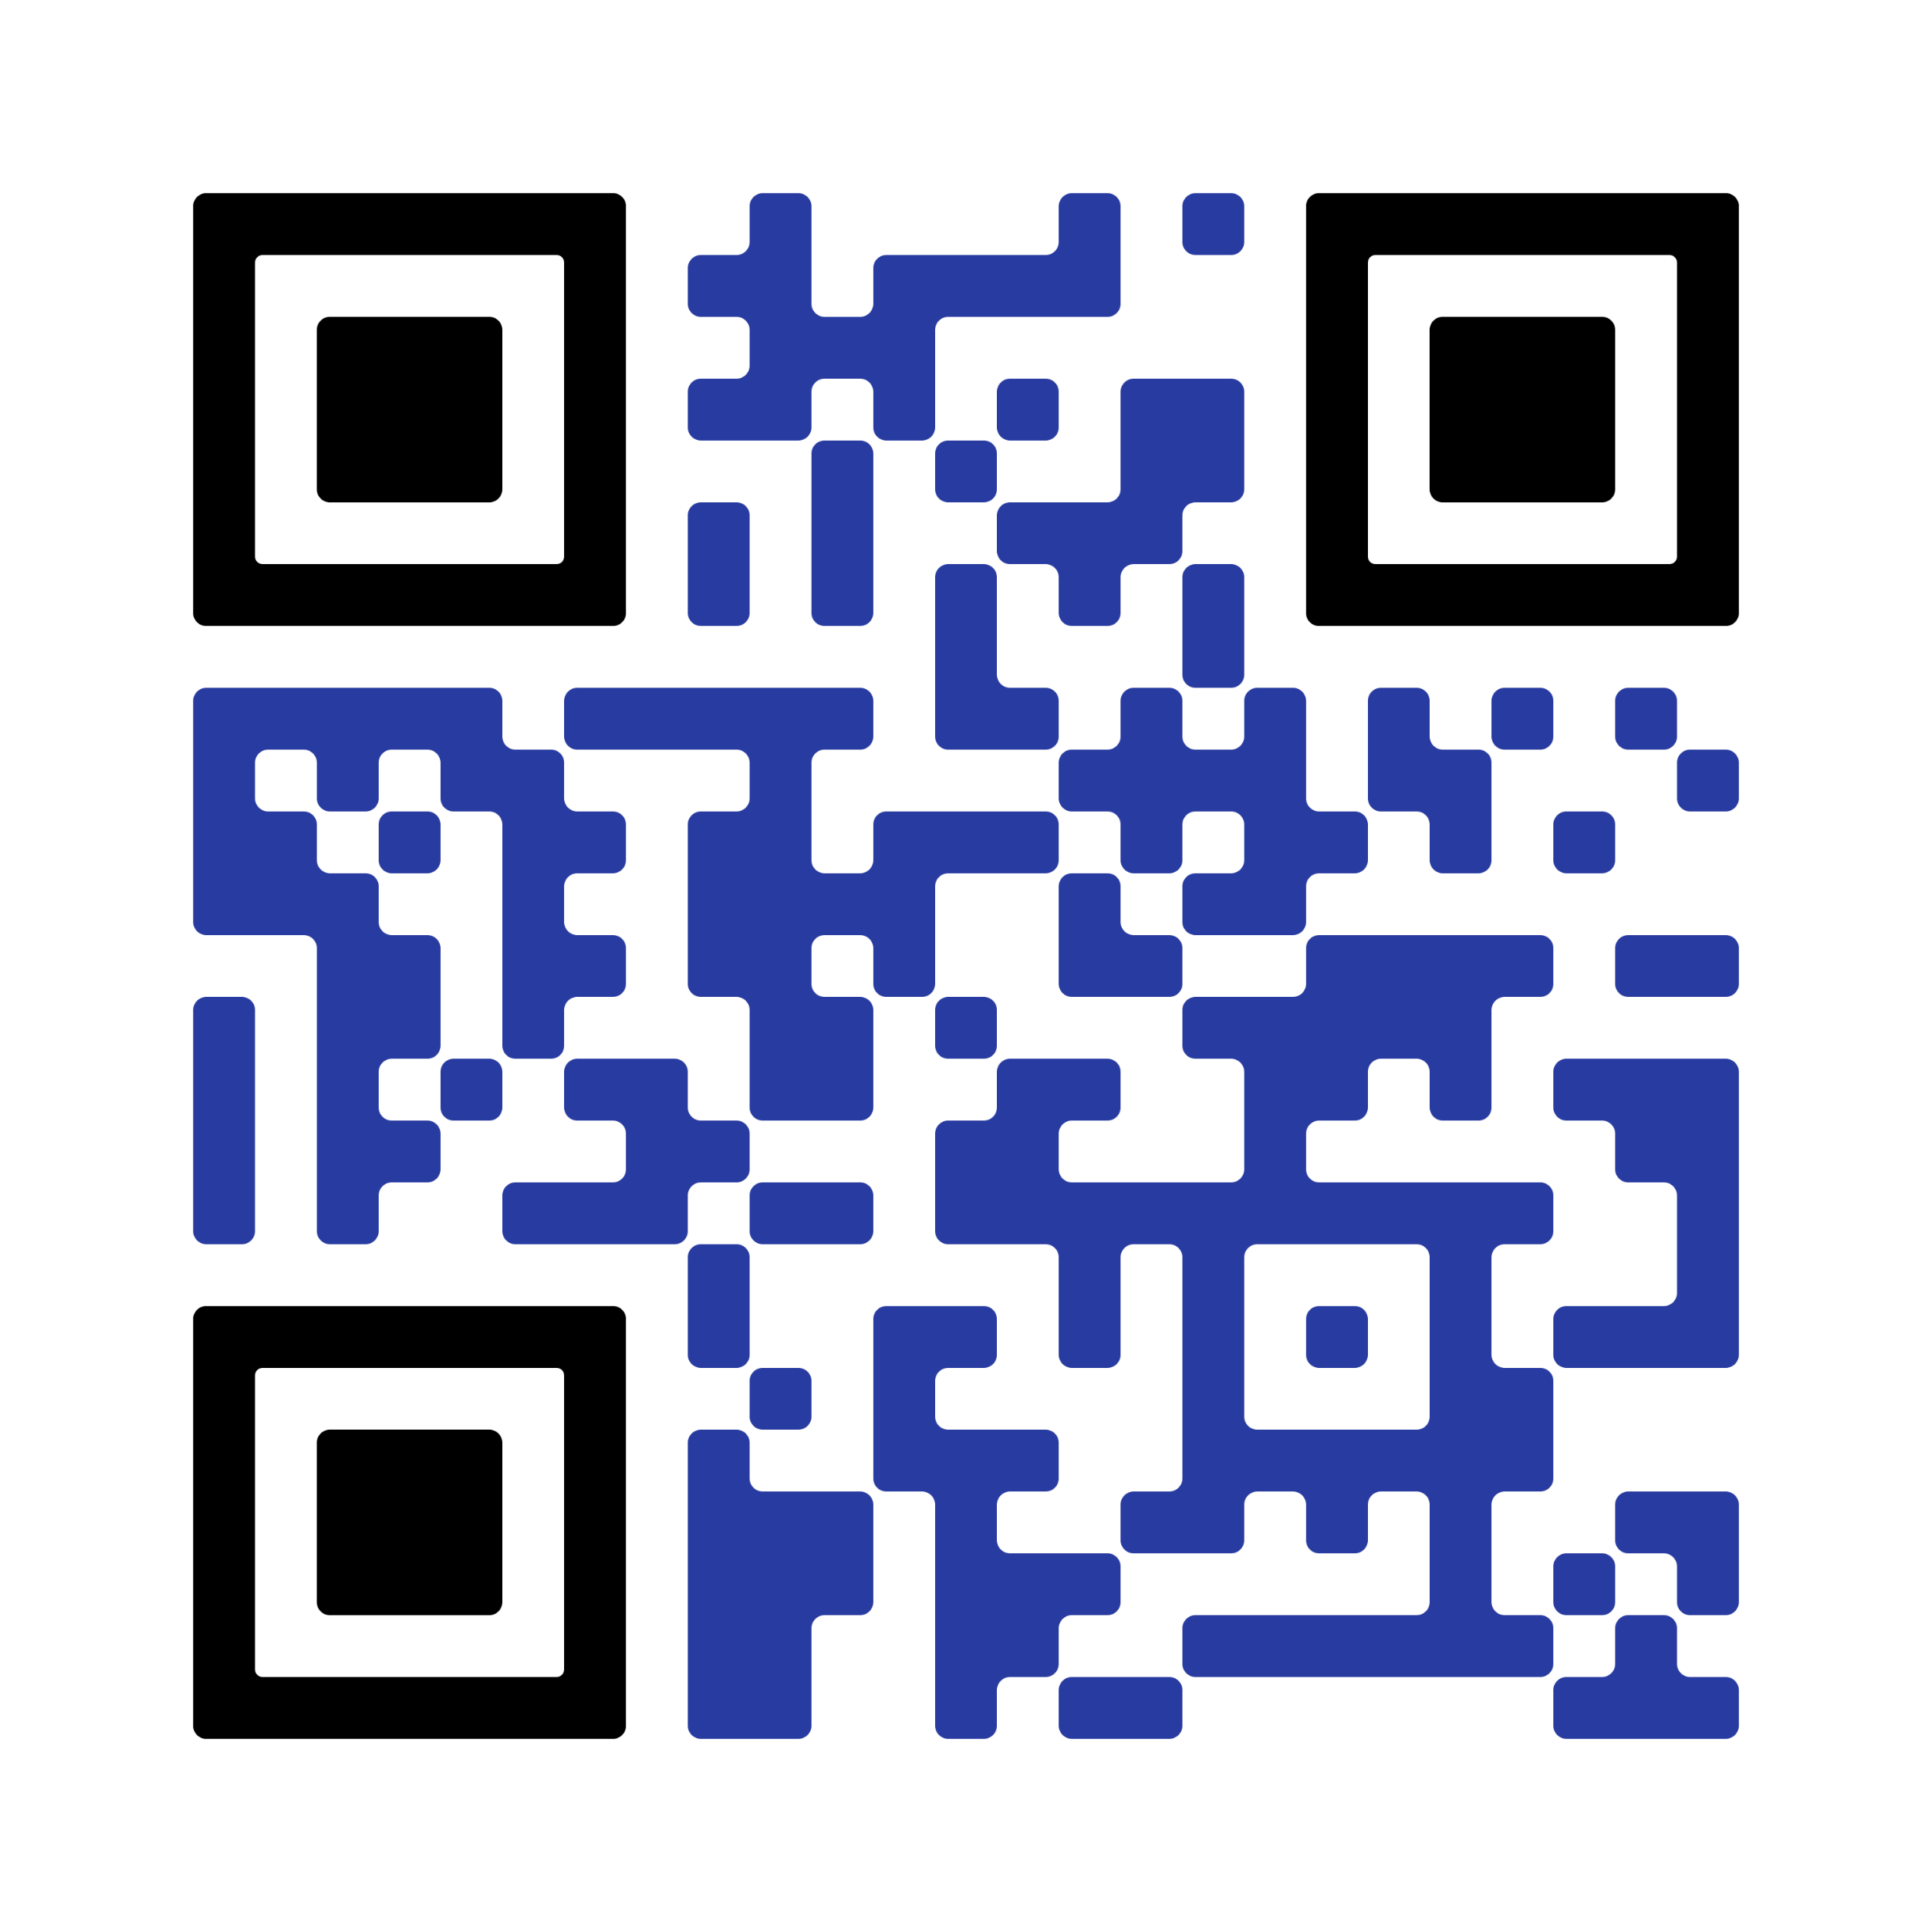


Poughkeepsie Galleria
APRIL 19TH - MAY 2ND

Slide 2


Poughkeepsie Galleria
APRIL 19TH - MAY 2ND

